Slide 1
Continuous vs Categorical Data, Regression vs classification, Images, Audios, Videos, Text Data

Slide 2
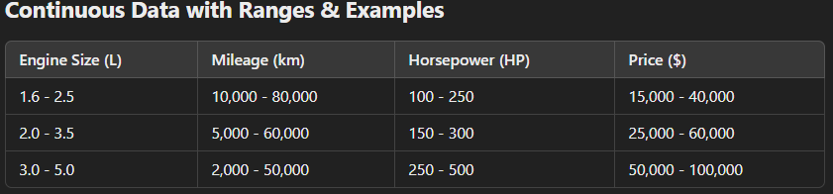
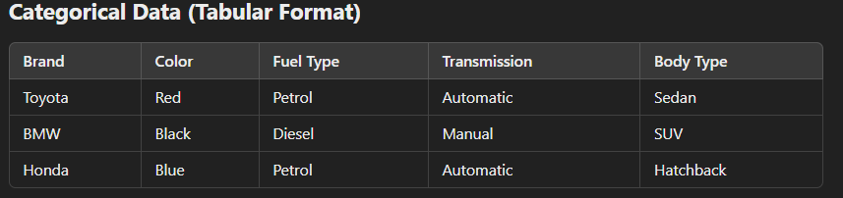
Continuous vs Categorical Data
Continuous Data: This type of data can take any value within a range. Examples include height, temperature, or time. They are typically measured on a continuous scale and can have fractional parts.
Categorical Data: This type involves data that can be divided into groups or categories that do not have an inherent numerical order. Examples include colors, types of cuisine, or survey responses like "Yes/No."

Slide 3
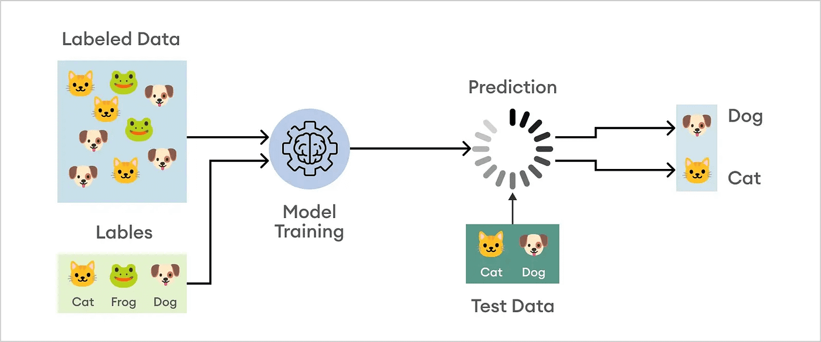
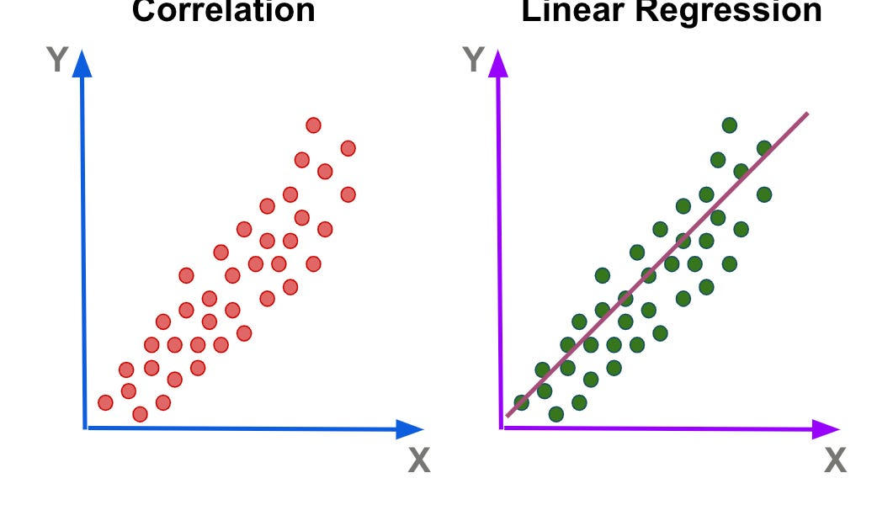
Classification vs Regression Data
Classification Data: In classification problems, the goal is to predict a discrete label or category. For example, determining whether an email is "spam" or "not spam" or classifying images into categories like "dog," "cat," or "bird."
Regression Data: Here, the objective is to predict a continuous value. This involves modeling the relationship between variables to forecast outcomes such as house prices, stock market trends, or temperature forecasts.

Slide 4
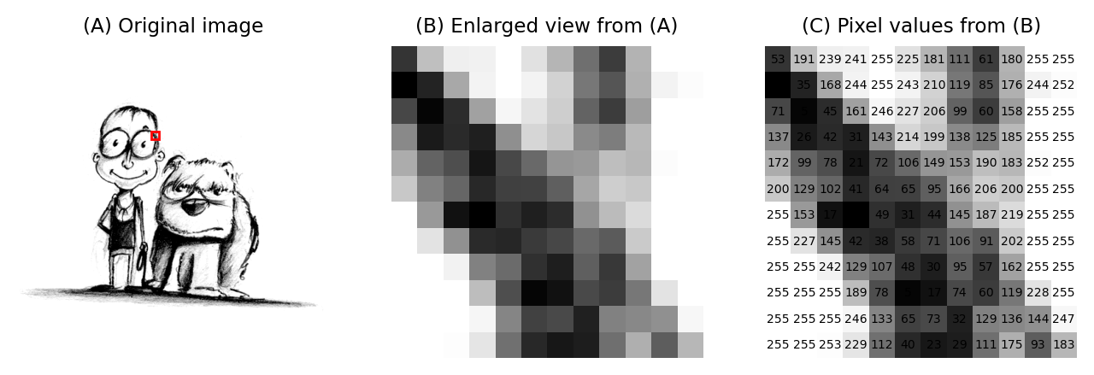
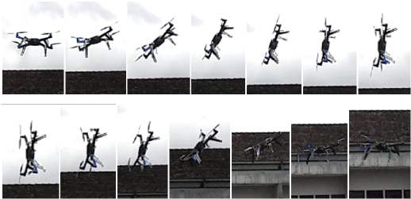
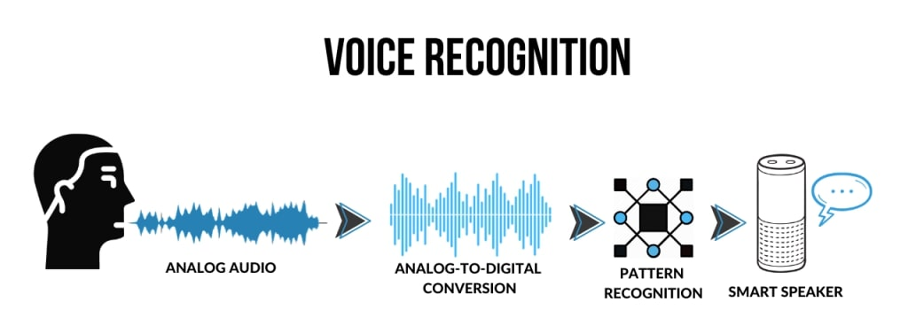
Images, Audio, Video, and Object Detection Data
Images, Audio, Video: These represent different types of multimedia data.
Images: Static pictures composed of pixels.
Audio: Sound recordings that capture various sound waves over time.
Video: Sequences of images (frames) that, when played in order, create the effect of motion.
Object Detection Data: This refers to annotated multimedia data (often images or video) used to train models to recognize and locate objects within a scene. It’s essential for applications like self-driving cars or surveillance systems.

Slide 5
Structured vs Unstructured Data
Structured Data: This data is organized in a fixed format, such as tables or spreadsheets, making it easy to search and analyze. Examples include SQL databases where information is stored in rows and columns.
Unstructured Data: This data does not have a predefined structure or format. Examples include text files, images, audio, and video. Analyzing unstructured data usually requires advanced processing techniques like natural language processing or computer vision.
Feature | Structured Data | Unstructured Data
Definition | Data that is organized and stored in a predefined format (e.g., tables, databases). | Data that does not have a fixed format or predefined structure.
Storage Format | Stored in relational databases (SQL, Excel, CSV). | Stored in files, documents, multimedia (videos, images, etc.).
Data Type | Numeric, categorical, or relational data. | Text, images, audio, video, social media posts.
Ease of Analysis | Easy to analyze using SQL, spreadsheets, and statistical tools. | Requires complex processing techniques like NLP, image recognition, or deep learning.
Scalability | Scales well with traditional database management systems. | Requires big data technologies like Hadoop, NoSQL, and AI-based processing.
Examples | Customer databases, financial transactions, inventory records. | Emails, chat messages, video recordings, social media posts.
Processing Tools | SQL, Excel, Pandas, relational databases. | NLP, Computer Vision, NoSQL databases (MongoDB, Hadoop).

